Slide 1

POISSON IMAGE BLENDING
19MIS212 –Mathematics for Intelligent Systems 4
TEAM INFINTY
APOORVA M AIE19007
TANUJ M AIE19041
AISHWARYA V AIE19068

Slide 2
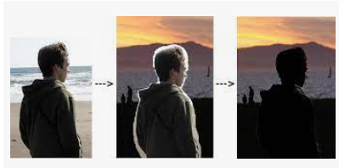
INTRODUCTION
Image blending is a method for image composition.
The output image is a combination of the corresponding pixel values of the input images.
Used in computer graphics and Image Processing Applications.
The challenge of this task is that the cropped region may not be precisely delineated.
Aim of image blending is to provide effortless transitions between image parts which can be obtained from different sources.

Slide 3
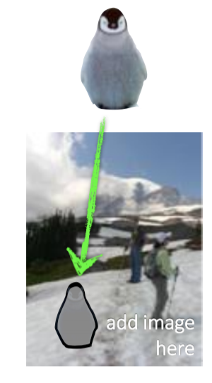
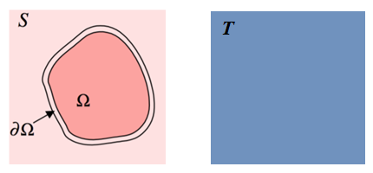
POISSON BLENDING
Reduce colour mismatch between Source and Target images.
Makes sure that the color of the inserted image is also shifted, so that the inserted object feels as if it is part of the environment of the target image

Slide 4
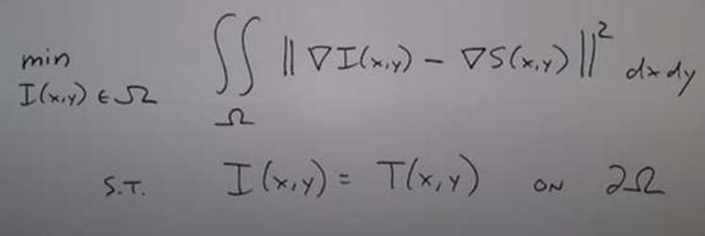
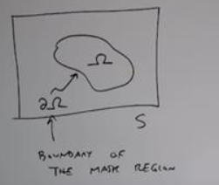
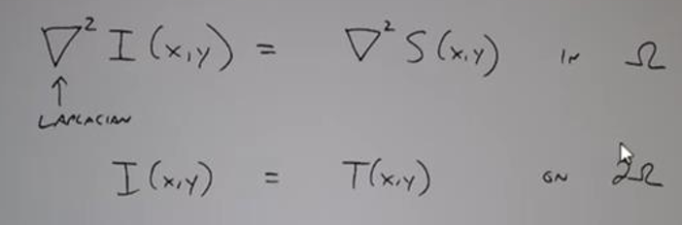
GOAL

Slide 5
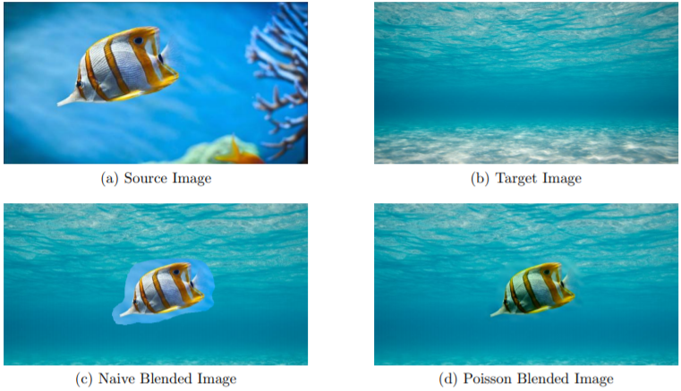

Slide 6
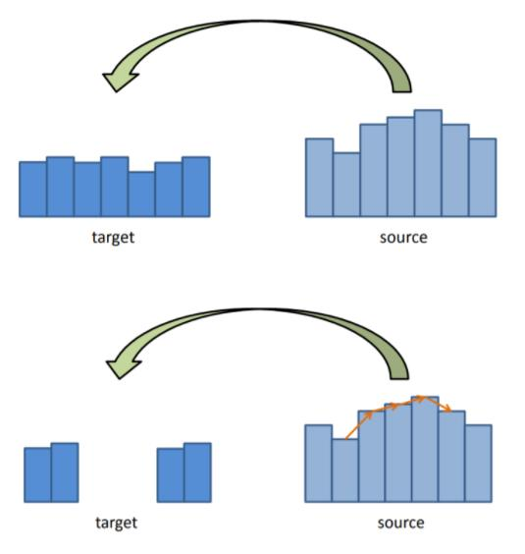
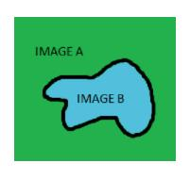
GRADIENT PRESERVING PROPERTY
BASIC IDEA

Slide 7
ALGORITHM
Preprocess Source, Target and Mask Images
Generate a Sparse Matrix
Blend each color channel seperately.

Slide 8
IMPLEMENTATION
Taking source image and target image from user
Create mask for region of interest in source image
Adjust the position of bounding box of the mask on target image
Naïve copy paste of source on target using mask
Doing Poisson/Mixed Gradient Blending to get a proper blending of cropped source image on target image
Displaying the results of Naïve blending and Poisson/Mixed Gradient blending

Slide 9
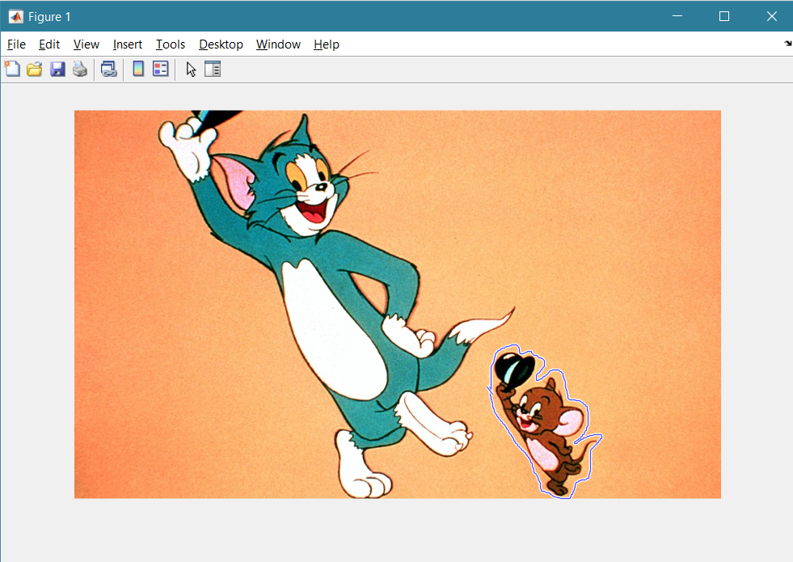
RESULTS

Slide 10
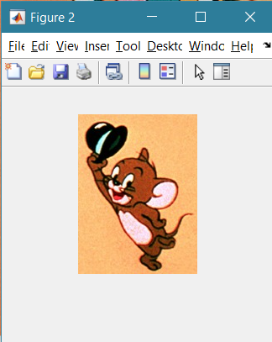
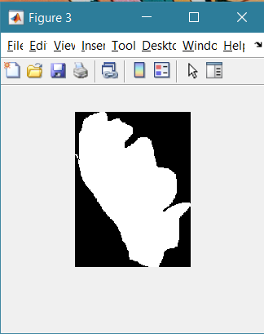

Slide 11
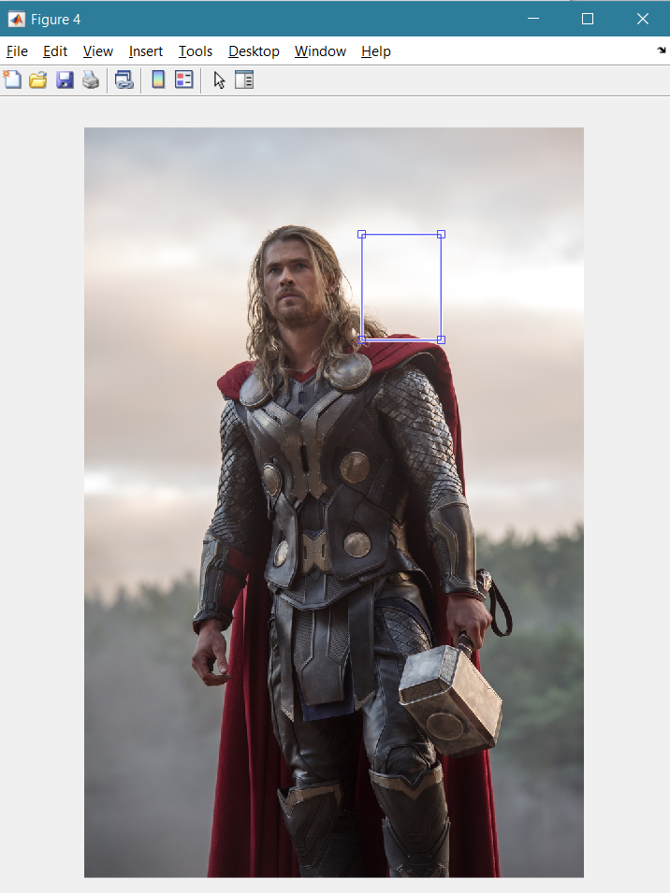
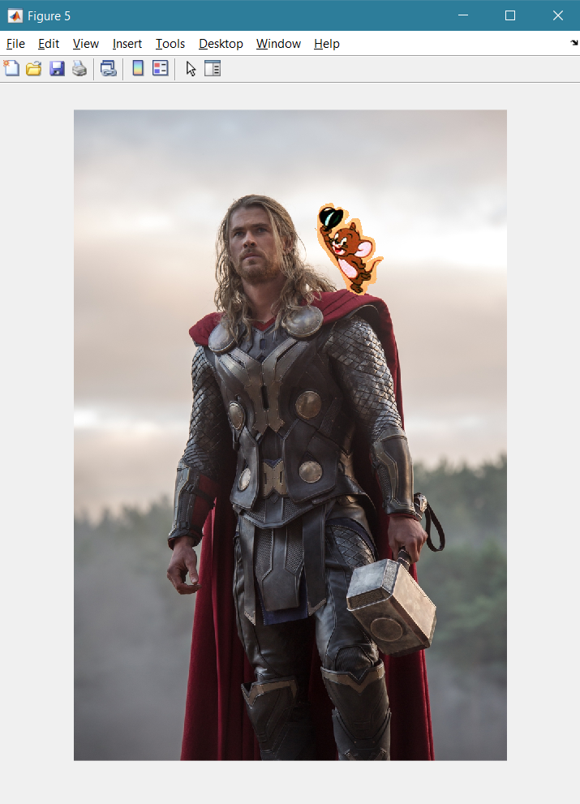

Slide 12
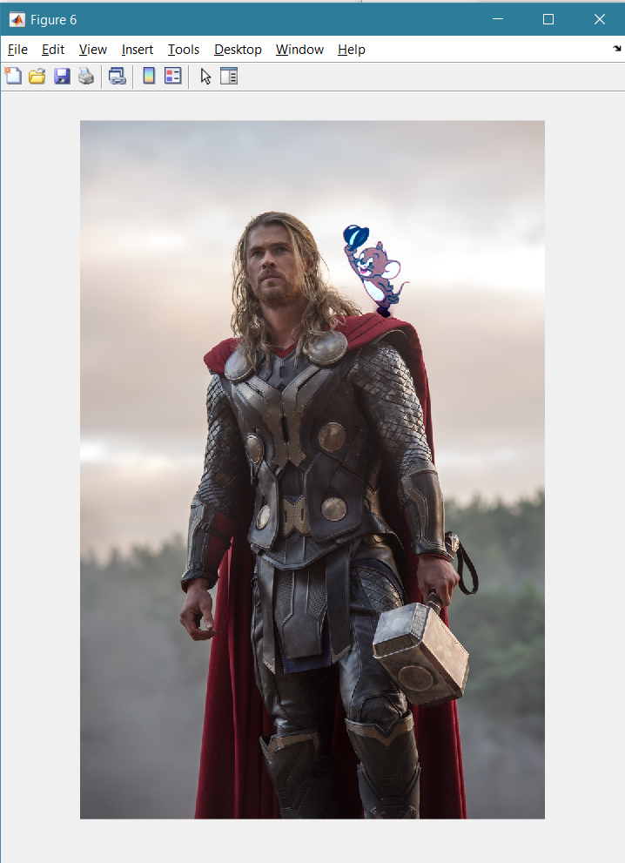

Slide 13
COUNCLUSION
Poisson method performed well when the images to be blended were of similar colour in nature. Significant variations in colours of the images resulted in colour distortions in the blended images which in some cases resulted in visible seams. The extent of possible changes ranges from replacement by, or mixing with, another source image region, to alterations of some aspects of the original image inside the selection, such as texture, illumination, or colour. An important common characteristic of all these tools is that there is no need for precise object delineation, in contrast with the classic tools that address similar tasks.
We have successfully blended source image on target image using Poisson blending.

Slide 14

THANK YOU

